Slide 1
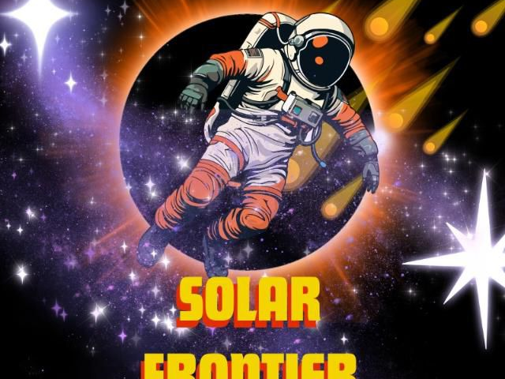
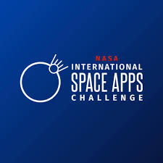

Slide 2
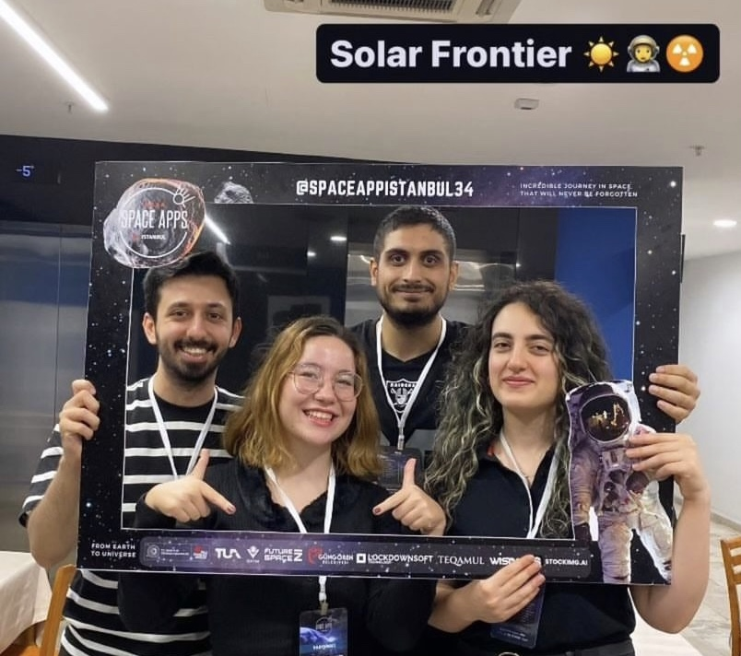
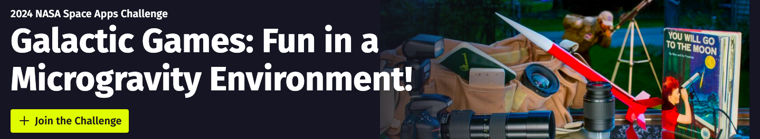

Yunus Emre
Mehmet Ali
Elif Melda
Gözde

Slide 3
Solar Frontier Represents AstroCo
Successful human space exploration depends on an astronaut's ability to maintain a high level of cognitive functioning in the presence of environmental and psychological stressors related to living in an isolated, confined and extreme (ICE) environment, where small errors can have catastrophic consequences[1] That’s why its crucial to keep the crew at their high performance.
As a team we designed games to measure and improve cognitive skills such as
KIRMIZI YEŞİL BALONCUK OYUNU - Motor Praxis Task (MP) , Psychomotor Vigilance Test (PVT)
MANCINIKLA UZAYA FIRLATILMA OYUNU - Visual Object Learning Test (VOLT),Psychomotor Vigilance Test (PVT)
3) FRAKTAL N-BACK- Fractal to back
KELİMELERLE NESNE EŞLEŞTİRME – Abstract Matching
5). UZAY LABİRENTİ OYUNU – Orientation- Direction
[1] Strangman GE, Sipes W, and Beven G. Human Cognitive Performance in Spaceflight and Analogue Environments. Aviat Space Environ Med 85, no. 10 (Oct 2014): 1033-48. PMID: 25245904

Slide 4
FrontireCrew AI
AI prompt Interface , evaluation assistant with NLP
Ask questions and after some time recommend a game for the required skill
It learns from the previous experience and create new serious of games

Slide 6
MANCINIKLA UZAYA FIRLATILMA OYUNU
KIRMIZI YEŞİL BALONCUK OYUNU
Purpose:
Motor Praxis Task (MP) : Measuring sensorimotor speed.
Psychomotor Vigilance Test (PVT) :To measure attention and reaction time
Purpose:
Psychomotor Vigilance Test (PVT) : :To measure attention and reaction time
To measure memory retention of complex shapes.

Slide 7
FRAKTAL N-BACK
KELİMELERLE NESNE EŞLEŞTİRME
UZAY LABİRENTİ OYUNU
Fractal to Back
Purpose: Measuring working memory.
Abstract Matching
Purpose : the abstraction and flexibility components.
Orientation- Direction Test (ODT)
Purpose: Measuring the accuracy of location-direction calculations

Slide 8
FUTURE WORK
We aim to develop the interface as a tool that can work with oral commands

